Slide 1

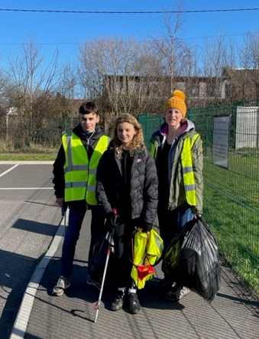
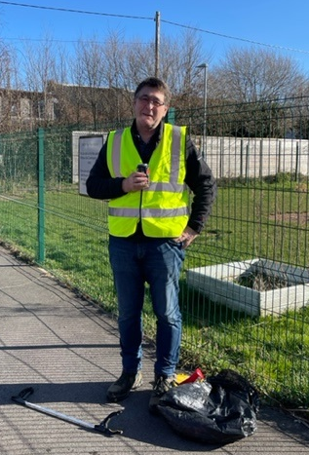
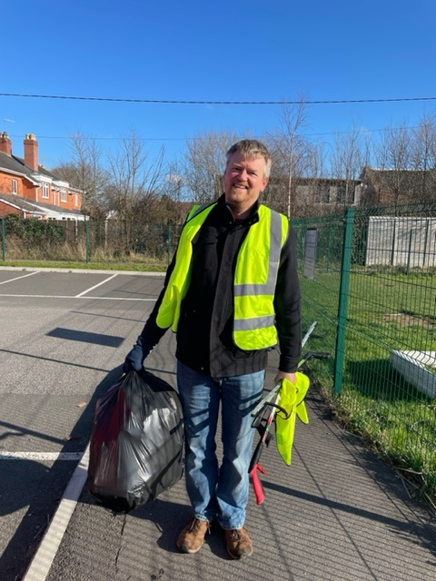
Volunteers Needed
Safety Equipment Provided
Thank you to all our litter pickers who came out to help keep the Parish tidy. However there is fair amount of litter being left around, especially near the school so if you would like to come along and help us on the last Sunday of the month then we would love to see you!
Coffee and cake to finish our morning from March!
Forthcoming litter picking dates:
Sunday 27th March 10am to 12 noon
Sunday 24th April 10am to 12 noon
Sunday 29th May 10am to 12 noon
To sign up as a volunteer, please get in touch with
Kate Welsh, Assistant Clerk (Community)
on 07505984006
or by email community@westmonkton.net
YOUR SUPPORT IS VERY MUCH APPRECIATED
Please note change of time – 10am to 12 noon

